Slide 1
Collection Types
Swift 2.0
Milla 2016/5/10

Slide 2
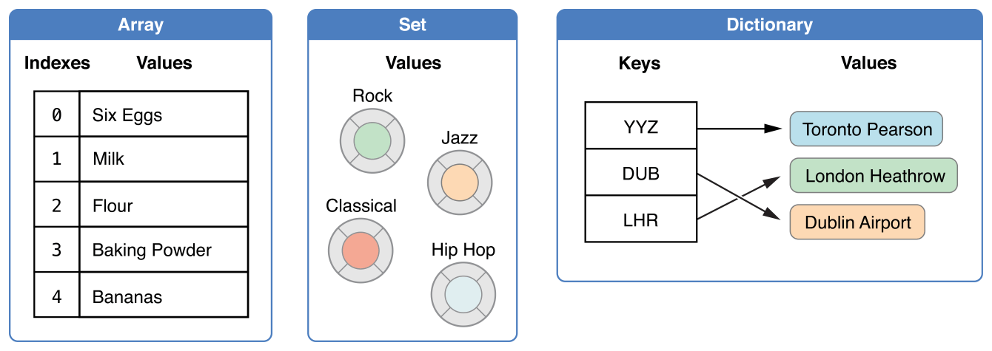
Collection Types
Arrays are ordered collections of values.
Sets are unordered collections of unique values.
Dictionaries are unordered collections of key-value associations

Slide 3
Mutability of Collections
var shoppingList: [String] = ["Eggs", "Milk"]
shoppingList.append("Mnnn")
let shoppingListLet: [String] = ["Eggs","Milk"]
shoppingListLet.append("MnnnLet")

Slide 4
Array
An array stores values of the same type in an ordered list.
The same value can appear in an array multiple times at different positions.
0 | 1 | 2 | 3 | 4 | 5 | 6 | 7
Miffy | 巧虎 | 佩佩豬 | Poli | 蘇非亞 | 芭比 | Miffy | Elsa

Slide 5
Empty Array
var someInts = [Int]()
print("someInts is of type [Int] with \(someInts.count) items.")
// Prints "someInts is of type [Int] with 0 items.”
Q:
var someInts = []()
var someInts = []
var someInts = [String]
var someInts = Array<String>()

Slide 6
Array Define
var shoppingList: [String] = ["Eggs", "Milk"]
var shoppingList = ["Eggs", "Milk"]

Slide 7
Array Default value
var threeDoubles = [Double](count: 3, repeatedValue:0.0) =>[0,0,0]
threeDoubles.append(0) => [0,0,0,0]
threeDoubles.append(“”) => X
var anotherThreeDoubles = Array(count: 3, repeatedValue: 2.5) =>[2.5,2.5,2.5]
var sixDoubles = threeDoubles + anotherThreeDoubles
=>[0,0,0,2.5,2.5,2.5]
Q:
anotherThreeDoublesInt = Array(count: 3, repeatedValue: 0)
var sixDoubles = threeDoubles + anotherThreeDoubles+ anotherThreeDoublesInt

Slide 8
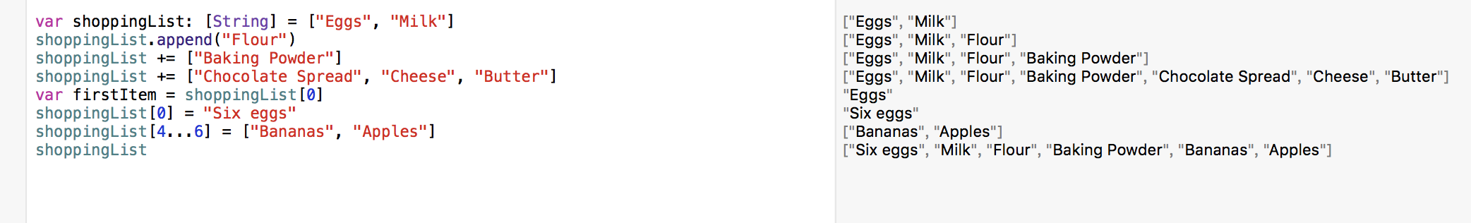
Array Access and Modify
shoppingList.count =>int
shoppingList.isEmpty =>boolean
shoppingList.append(Element) =>void
shoppingList += ["Baking Powder"]
shoppingList += ["Chocolate Spread", "Cheese", "Butter"]
var firstItem = shoppingList[0]
shoppingList[0] = "Six eggs”
shoppingList[4...6] = ["Bananas", "Apples"]

Slide 9
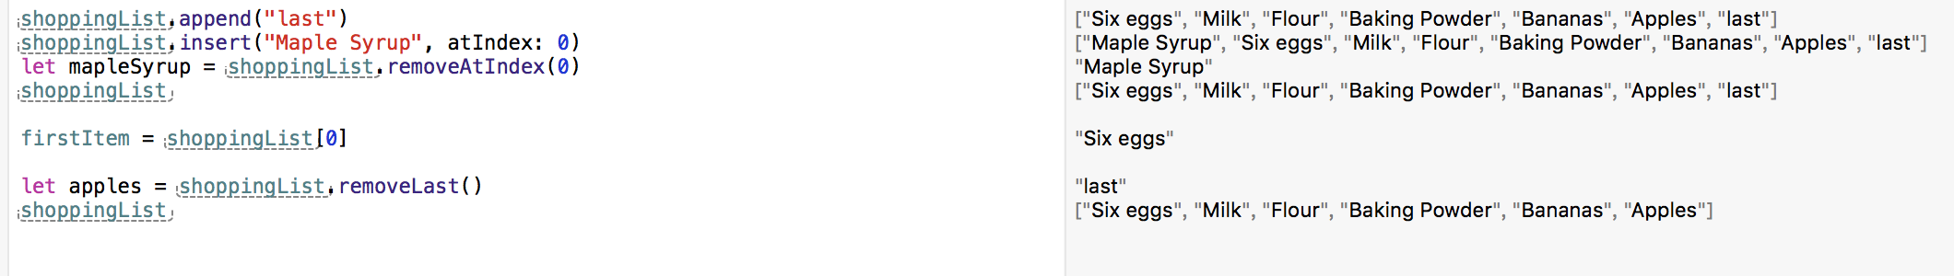
Array Insert and Remove
shoppingList.append("last")
shoppingList.insert("Maple Syrup", atIndex: 0)
let mapleSyrup = shoppingList.removeAtIndex(0)
shoppingList.removeLast()

Slide 10
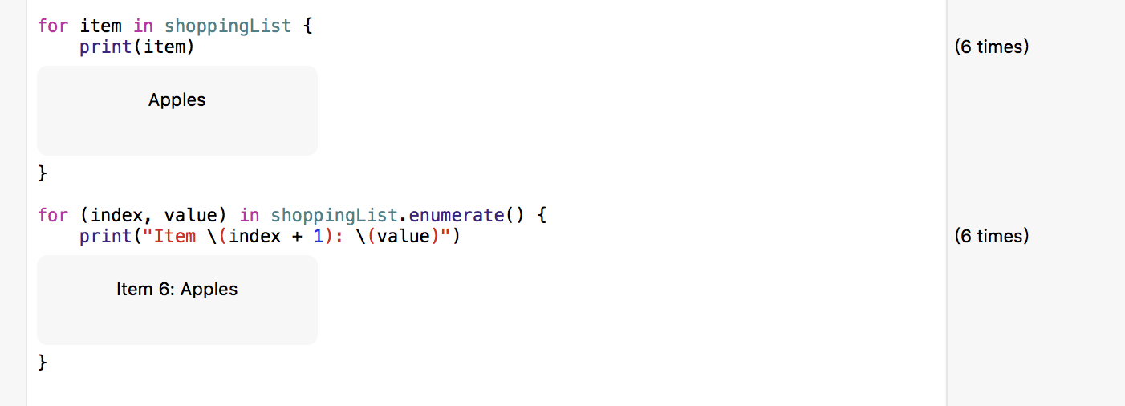
Array Iterate
for item in shoppingList
for (index, value) in shoppingList.enumerate()

Slide 11
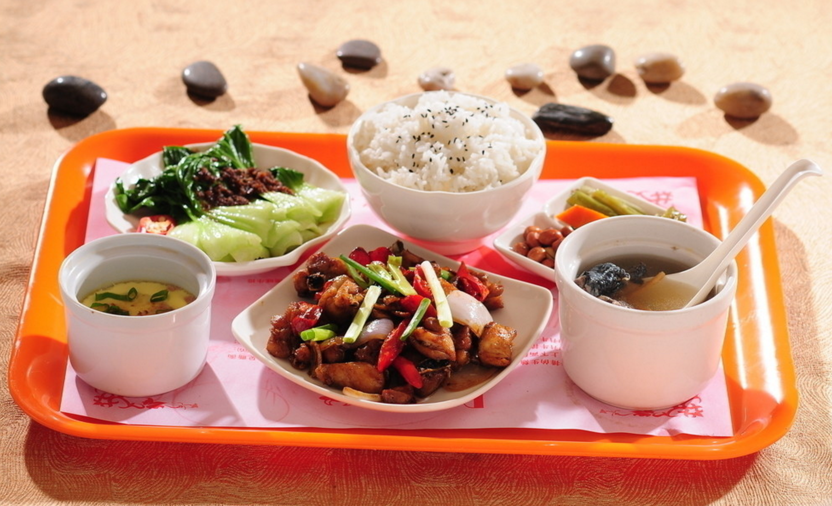
Sets
沒有順序性
值不會重覆

Slide 12
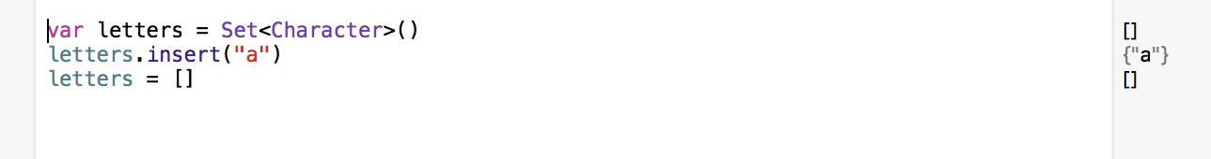
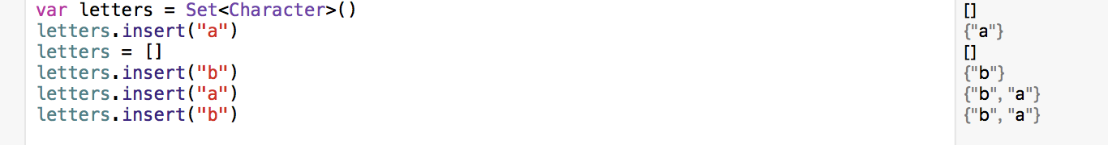
Empty Set
var letters = Set<Character>()
Still of type Set<Character>

Slide 13
Set Define
var favoriteGenres: Set<String> = ["Rock", "Classical", "Hip hop"]
var favoriteGenres: Set = ["Rock", "Classical", "Hip hop"]

Slide 14
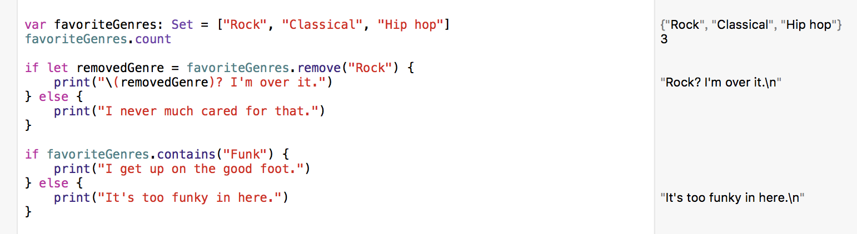
Set Access & Modify
favoriteGenres.count => int
favoriteGenres.isEmpty => boolean
favoriteGenres.insert(Element) => void
favoriteGenres.remove("Rock")
favoriteGenres.contains("Funk")

Slide 15
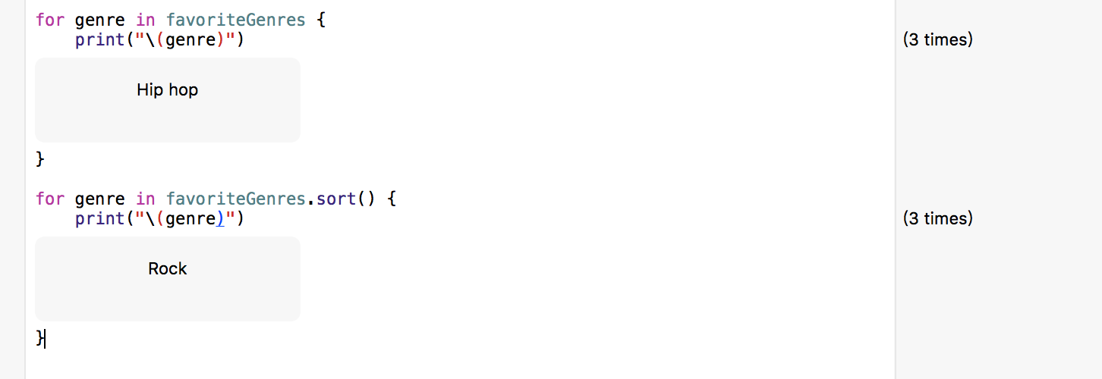
Set Iterate
for genre in favoriteGenres
for genre in favoriteGenres.sort()

Slide 16
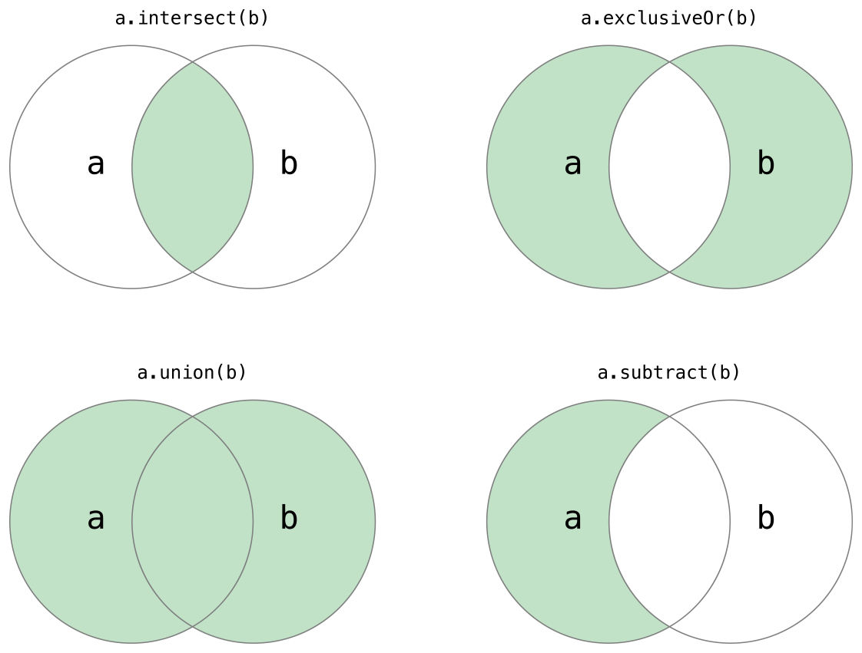
Set Operation

Slide 17
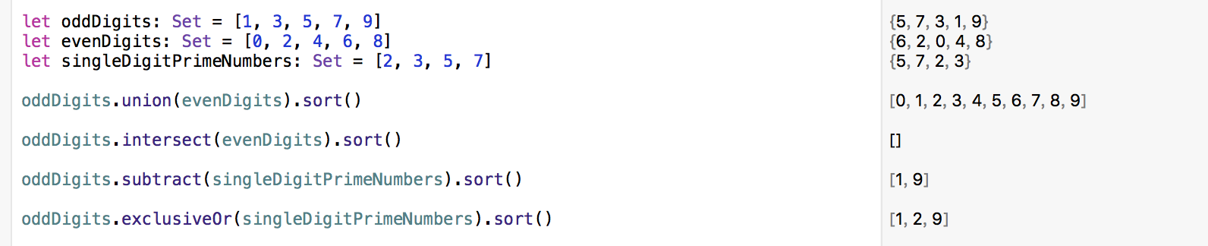
Set Operation
intersect(_:)取兩個Set裡重覆的值
exclusiveOr(_:)取兩個Set不重覆的值
union(_:)取兩個Set全部的值但不會重復出現
subtract(_:)取第一個Set裡不跟第二個Set重覆的值

Slide 18
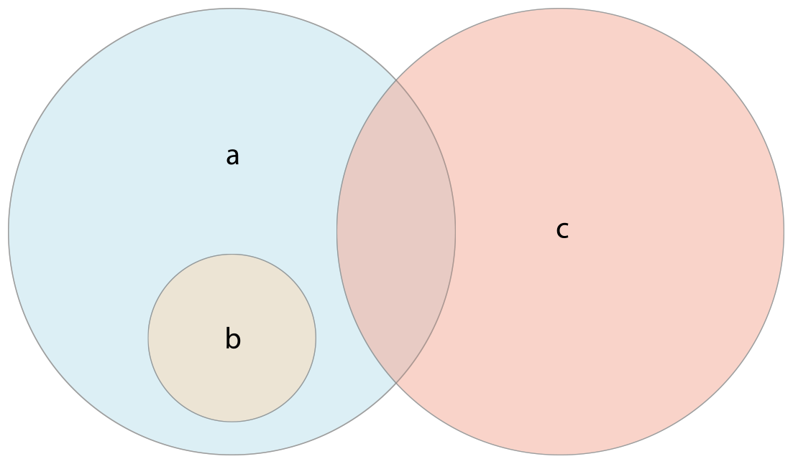
Set Membership and Equality

Slide 19
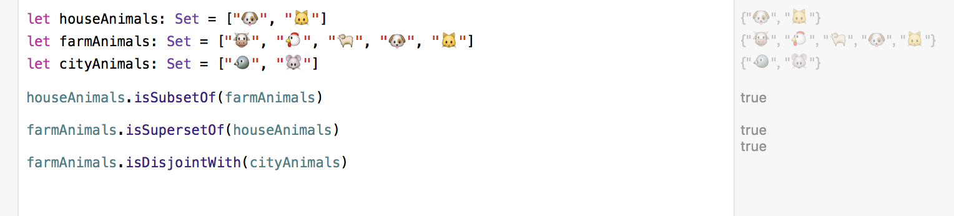
Set Membership and Equality
==
a.isSubsetOf(b)： 判斷a的所有內容是否都在b裡
a.isSupersetOf(b)： 判斷a是否包含了所有b的內容
isStrictSubsetOf 以及 isStrictSupersetOf 跟上面兩個一樣，只是a跟b不能是一樣的
a.isDisjoinWith(b)： 判斷a跟b有沒有重覆的內容

Slide 20
Dictionaries
Key, value : keys of the same type and values of the same type.

Slide 21
Empty Dictionaries
var namesOfIntegers = Dictionary<Int, String>()
var namesOfIntegers = [Int: String]()

Slide 22
Dictionaries Define
var airports: [String: String] = ["YYZ": "Toronto Pearson", "DUB": "Dublin"]
var airports = ["YYZ": "Toronto Pearson", "DUB": "Dublin"]

Slide 23
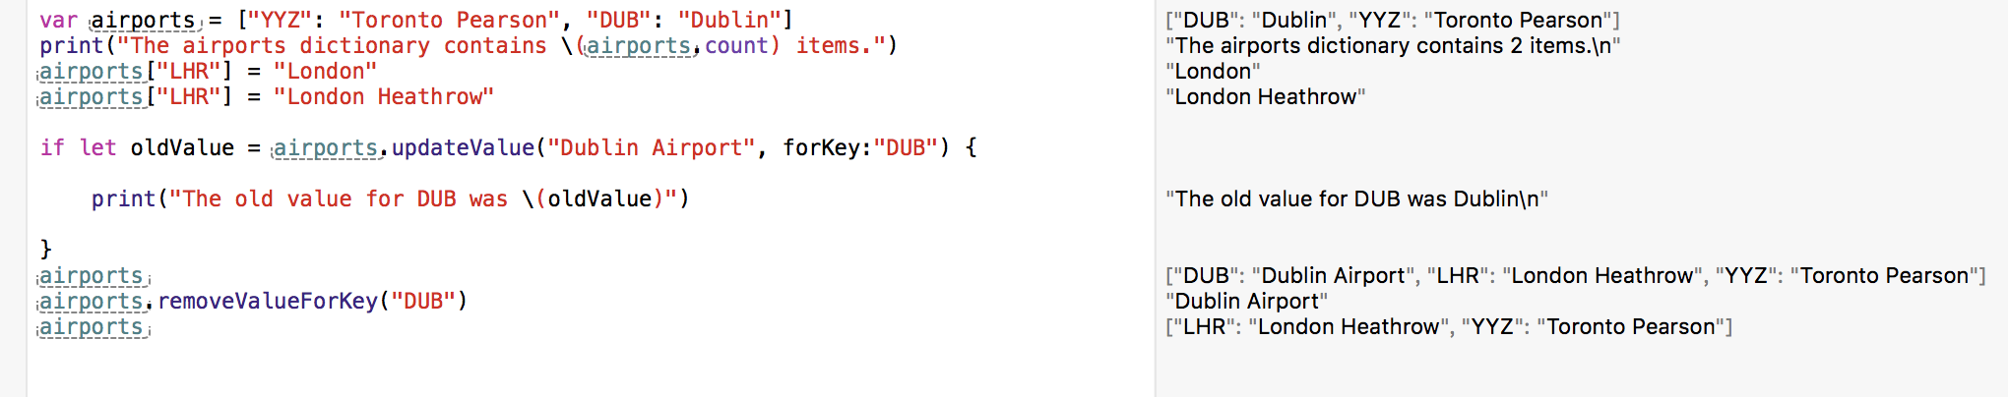
Dictionaries Access & Modify
airports.count =>int
airports.isEmpty =>boolean
airports[“LHR”] = “London” 插入一組新的key-value
airports[“LHR”] = “London Heathrow” modify
updateValue(_:forKey:)
removeValueForKey(_:)

Slide 24
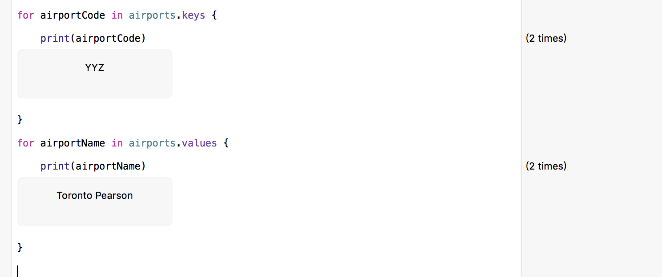
Dictionaries Iterate
for airportCode in airports.keys
for airportName in airports.values

